Slide 1


What is XAI ?
Explainable AI (XAI), Interpretable AI, or Transparent AI refer to techniques in artificial intelligence (AI) which can be trusted and easily understood by humans. It contrasts with the concept of the "black box" in machine learning where even their designers cannot explain why the AI arrived at a specific decision.

Slide 2

Why XAI?
At the dawn of the fourth industrial revolution, we are witnessing a fast and widespread adoption of artificial intelligence (AI) in our daily life.
There has been a surge of complex black-box models with high performance, such CNN, RNN, Attention-based models. On the other hand, the application of these models especially in high-risk domains is more stagnant due to lack of explainability and interpretability.
This issue has triggered a new debate on explainable AI (XAI).

Slide 3
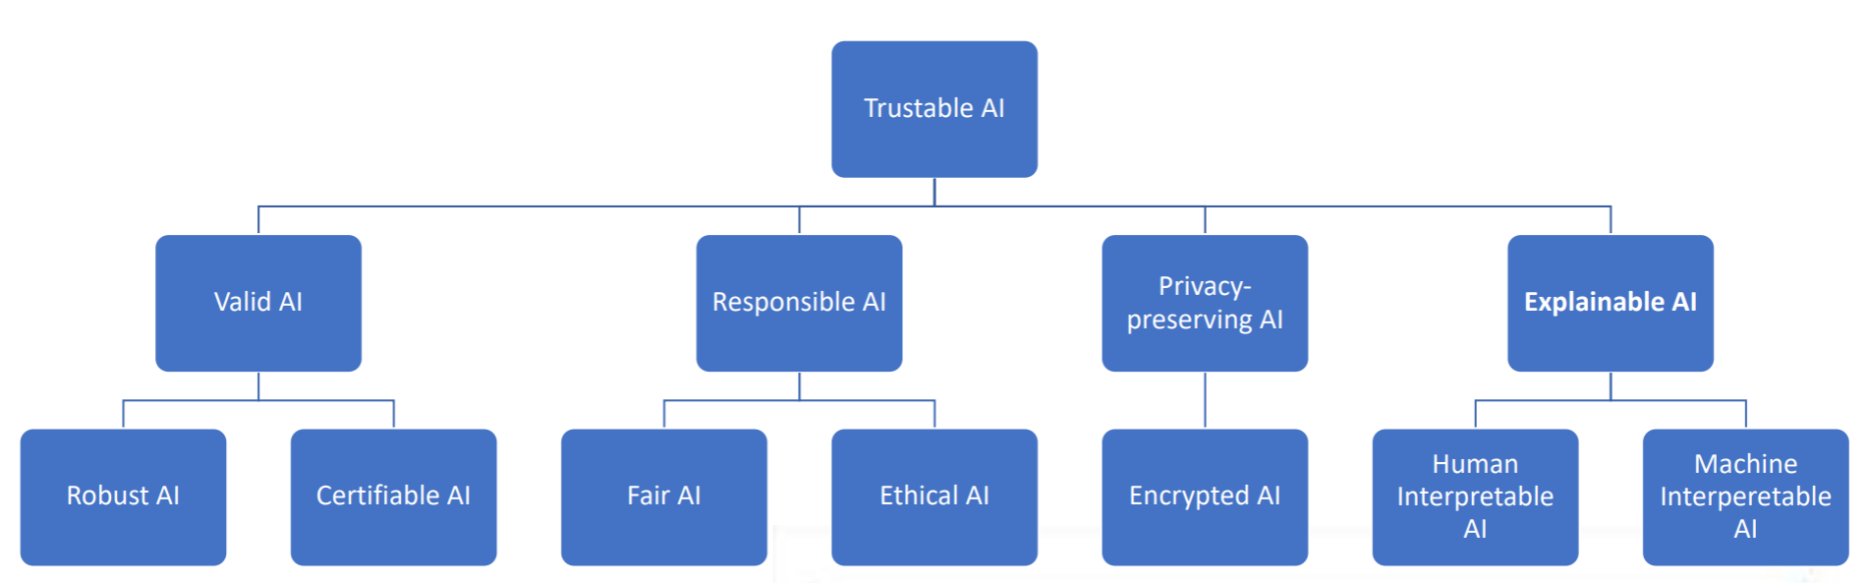
AI Context for Industrial Adoption
—— AAAI 2019, Tutorial on Explainable AI

Slide 4
Open Challenges for XAI
—— AAAI 2019, Tutorial on Explainable AI

Slide 5
Open Challenges
—— AAAI 2019, Tutorial on Explainable AI
• More formal studies on interpretability
• Rigorous, agreed upon evaluation protocols
• More work on transparent design
• Human involvement (e.g. better interactive, “social” explanations) [Miller 2017]
• Define industry standards (e.g. AI Service Factsheet [Hind et al. 2018)]
• Improve existing legislation
• Legislation & Explanations: How accurate ? How complete? How faithful to the model? [Rudin 2018]

Slide 6
Open Challenges
—— AAAI 2019, Tutorial on Explainable AI
• More formal studies on interpretability
• Rigorous, agreed upon evaluation protocols
• More work on transparent design
• Human involvement (e.g. better interactive, “social” explanations) [Miller 2017]
• Define industry standards (e.g. AI Service Factsheet [Hind et al. 2018)]
• Improve existing legislation
• Legislation & Explanations: How accurate ? How complete? How faithful to the model? [Rudin 2018]
Yet, visualization is considered to be an essential technique to tackle the challenges above.
Let’s see how it work.

Slide 7
Case Study of XAI
Image classification

Slide 8
Case Study of XAI
Image classification
Class Activation Mapping
Saliency Maps
Guided BackPropagation
Grad-CAM
SHapley Additive exPlanations

Slide 9
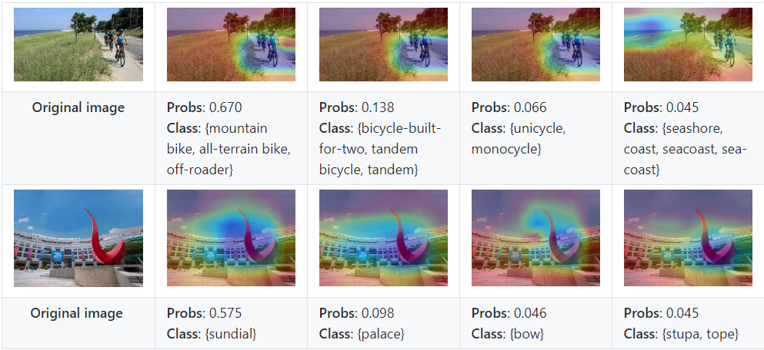
Case Study of XAI
Image classification
Class Activation Mapping
Saliency Maps
Guided BackPropagation
Grad-CAM
SHapley Additive exPlanations

Slide 10
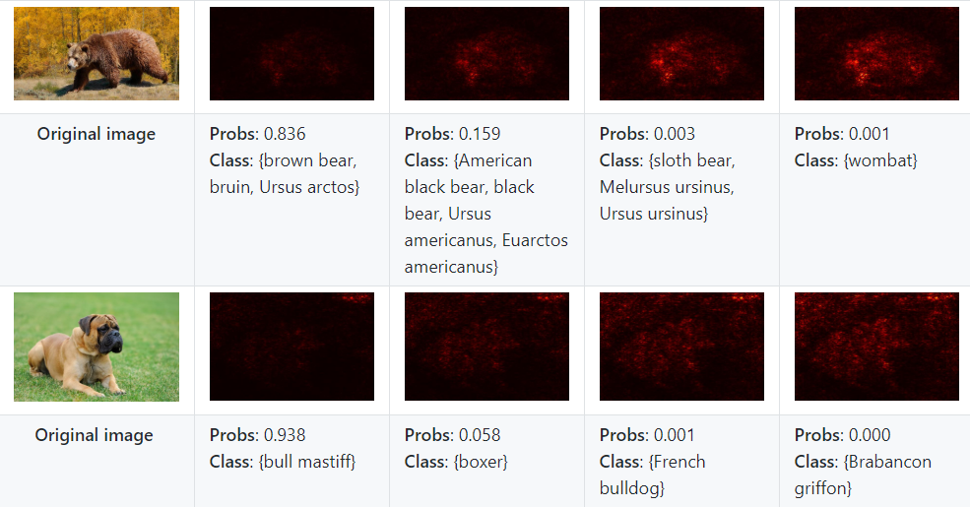
Case Study of XAI
Image classification
Class Activation Mapping
Saliency Maps
Guided BackPropagation
Grad-CAM
SHapley Additive exPlanations

Slide 11
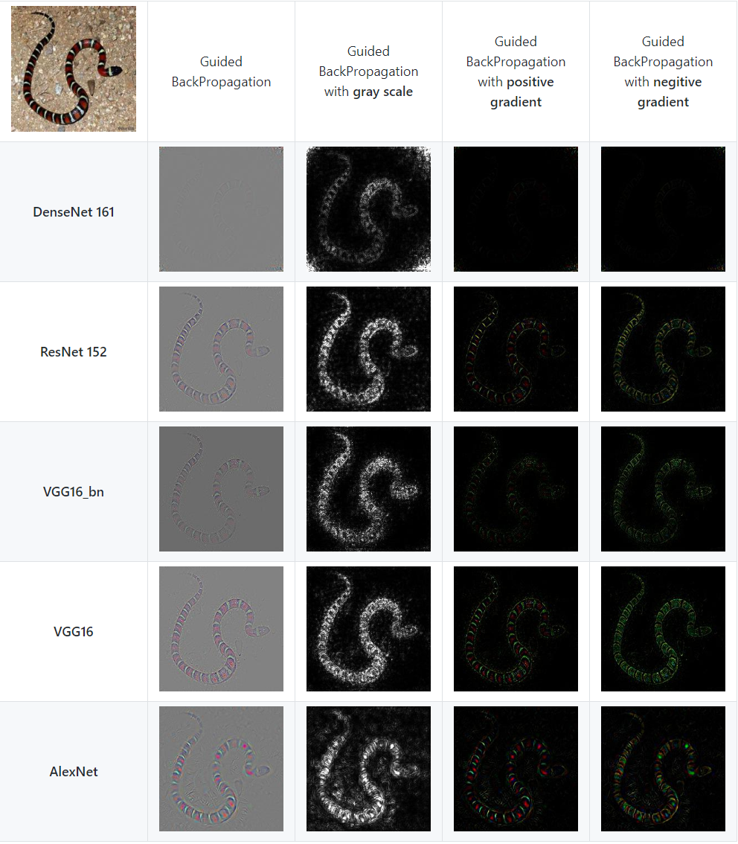
Case Study of XAI
Image classification
Class Activation Mapping
Saliency Maps
Guided BackPropagation
Grad-CAM
SHapley Additive exPlanations

Slide 12
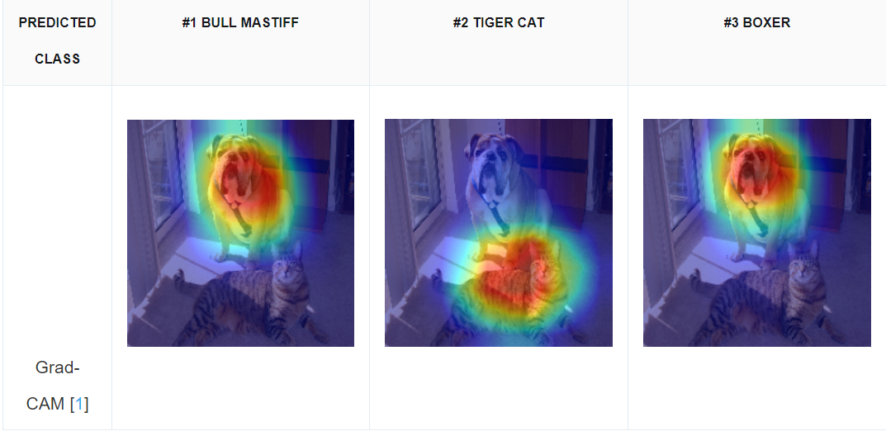
Case Study of XAI
Image classification
Class Activation Mapping
Saliency Maps
Guided BackPropagation
Grad-CAM
SHapley Additive exPlanations

Slide 13
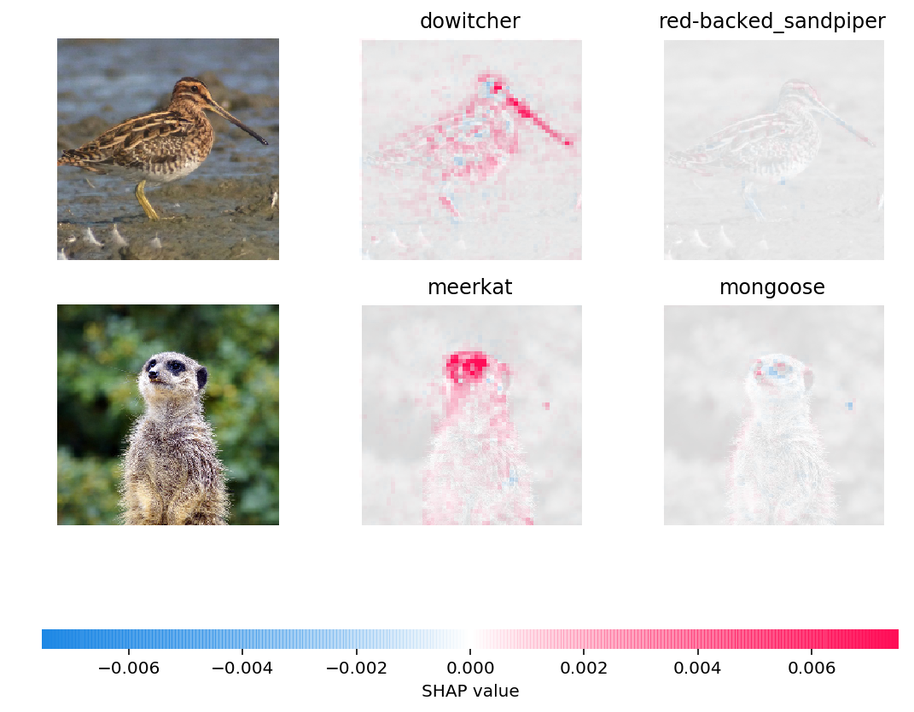
Case Study of XAI
Image classification
Class Activation Mapping
Saliency Maps
Guided BackPropagation
Grad-CAM
SHapley Additive exPlanations

Slide 14
Case Study of XAI
Natural Language Processing

Slide 15
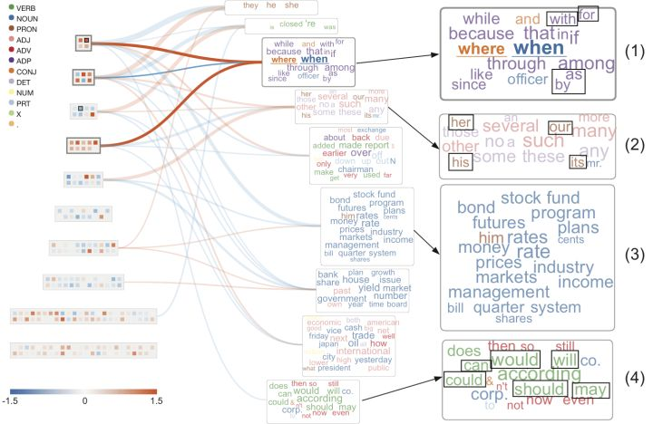
Case Study of XAI
Natural Language Processing
RNNVIS
LSTMVIS
Seq2Seq-VIS
Attention-VIS

Slide 16
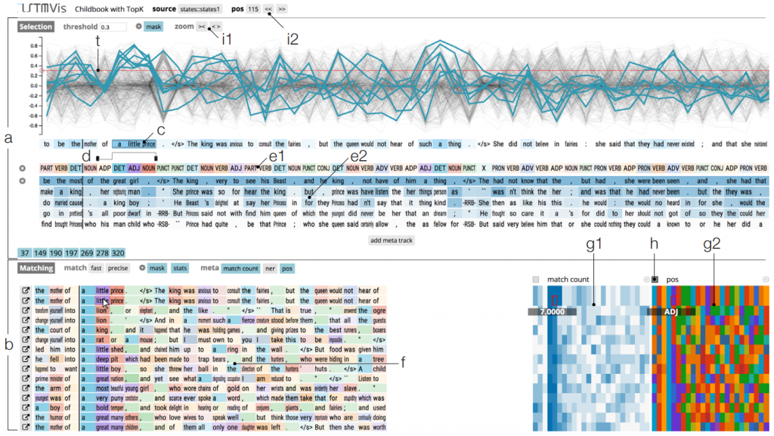
Case Study of XAI
Natural Language Processing
RNNVIS
LSTMVIS
Seq2Seq-VIS
Attention-VIS

Slide 17
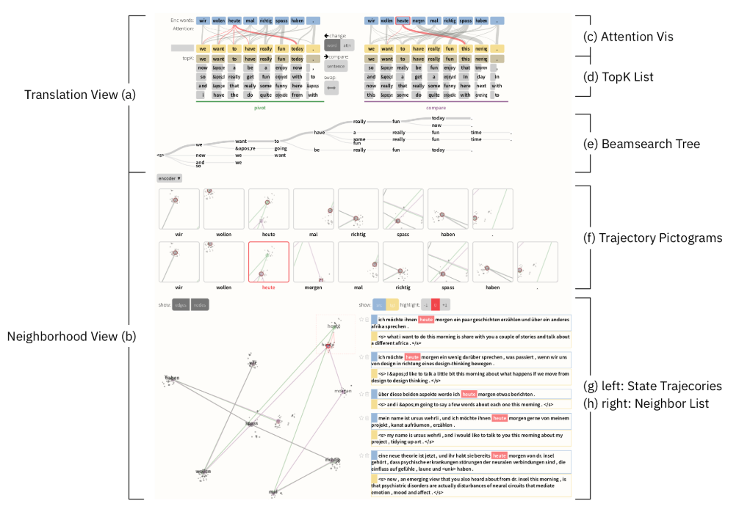
Case Study of XAI
Natural Language Processing
RNNVIS
LSTMVIS
Seq2Seq-VIS
Attention-VIS

Slide 18
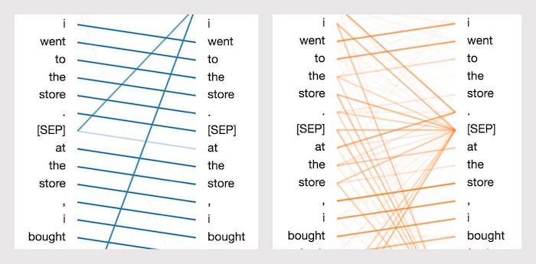
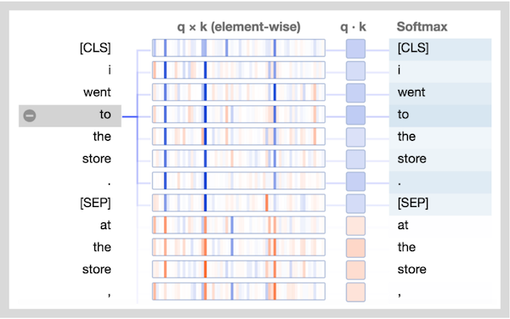
Case Study of XAI
Natural Language Processing
RNNVIS
LSTMVIS
Seq2Seq-VIS
Attention-VIS

Slide 19



XAI PROGRESS
Tutorials and workshops where XAI showed up in recent years.
2017
2018
2019
IJCAI
IEEE VIS
IEEE VIS
AAAI
IJCAI 2017 Workshop on Explainable Artificial Intelligence (XAI)
1st Workshop on Visualization for AI Explainability
2nd Workshop on Visualization for AI Explainability
AAAI 2019 Tutorial On Explainable AI
NIPS
IJCAI/ECAI
IJCAI
CVPR
Interpretable ML Symposium
IJCAI/ECAI 2018 Workshop on Explainable Artificial Intelligence (XAI)
IJCAI 2019 WORKSHOP ON
EXPLAINABLE ARTIFICIAL INTELLIGENCE (XAI)
CVPR-19 Workshop on Explainable AI
ICML
ICAPS
ICCC
2018 Workshop on Human Interpretability in Machine Learning (WHI)
2nd ICAPS Workshop on
Explainable Planning (XAIP-2019)
2019 ICCV Workshop on Interpreting
and Explaining Visual Artificial Intelligence Models
NIPS &GOOGLE BRAIN
HCI
Visualization for Machine Learning
Human-Centered Machine Learning
Perspectives Workshop

